Slide 1

Adidas Sales Analysis - PowerBI Dashboard
by. ROSHAN JADHAV

Slide 2
Overview of the Dashboard
This Power BI dashboard provides a comprehensive analysis of Adidas sales performance, leveraging various charts and data visualizations to offer actionable insights.
It includes key metrics, regional breakdowns, and interactive filters, enabling users to drill down into specific areas of interest and explore trends over time.

Slide 3
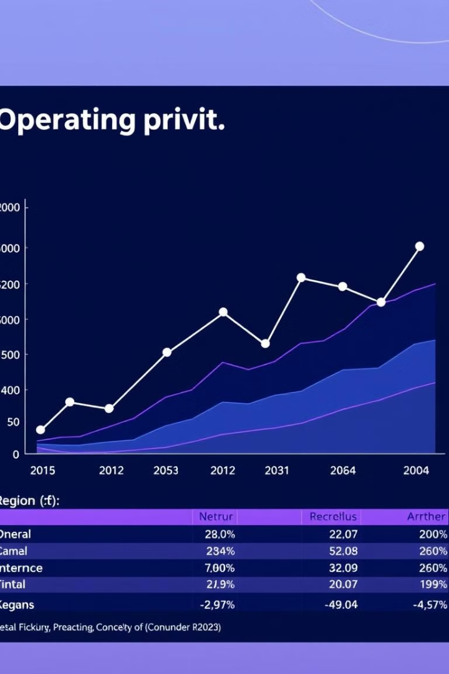
Operating Profit by Region (Line Chart)
1
Trend Analysis
2
Regional Performance
The line chart displays the operating profit by region over a specified time period, allowing for trend identification and comparison across different geographic areas.
Users can easily spot regions with strong or weak profit performance and identify key contributing factors.
3
Growth Opportunities
By analyzing trends, the dashboard highlights potential growth opportunities and areas for improvement.

Slide 4
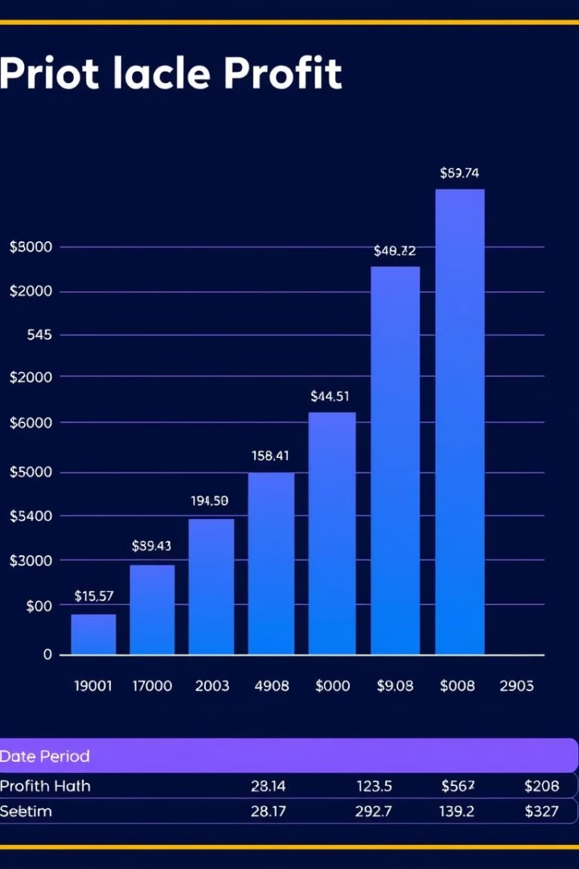
Profit by Region (Bar Chart)
Regional Profit Breakdown
Comparison and Analysis
The bar chart provides a clear visual representation of profit generated by each region during a selected time frame.
Users can easily compare profit performance across regions, identifying both high-performing and underperforming areas.
Actionable Insights
The data allows for targeted interventions to boost profit in specific regions and optimize overall performance.

Slide 5
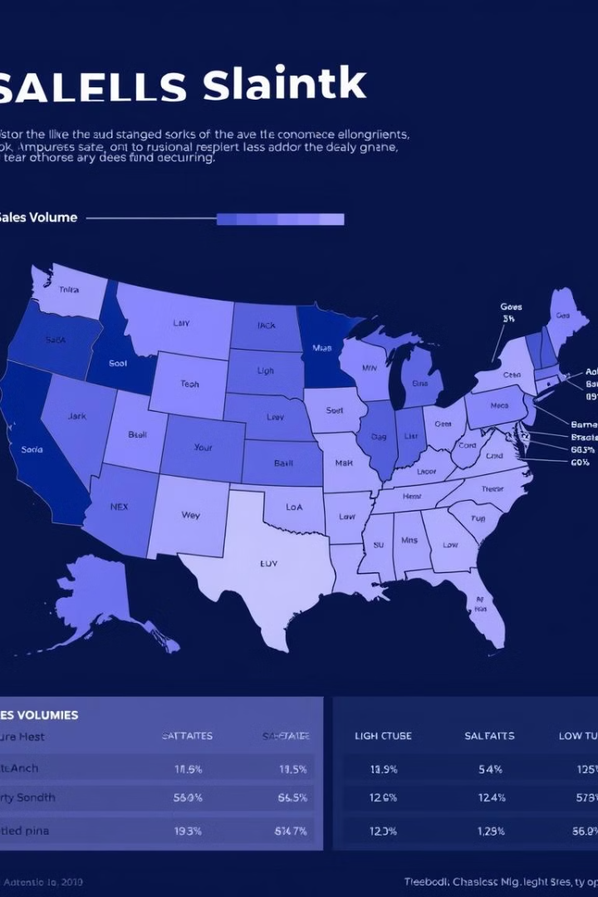



Sales by State (Map Chart)
Geographic Insights
Sales Concentration
The map chart visualizes sales performance across different states within a specific region or country.
Users can identify areas of high sales concentration and areas with potential for growth.
Market Analysis
The map provides valuable insights for market analysis and strategic decision-making.

Slide 6
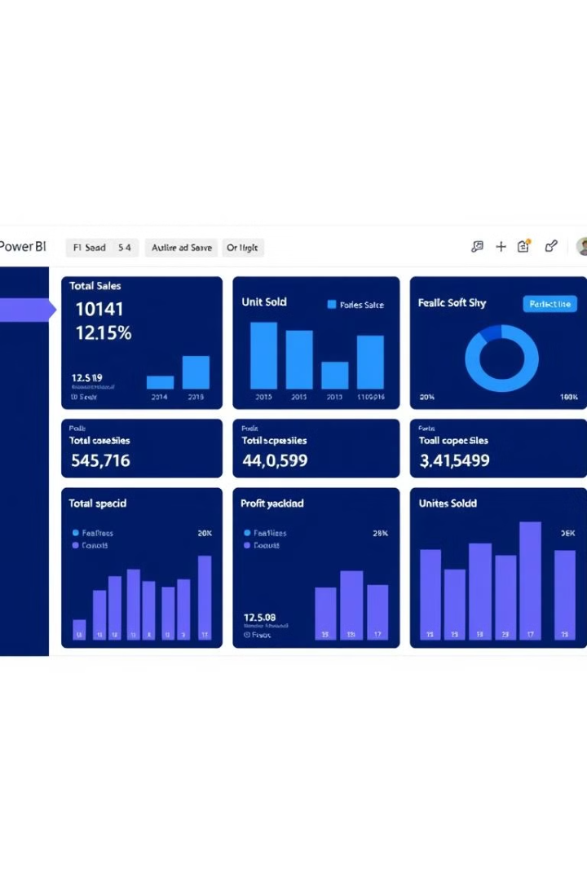
Key Metrics (Cards)
899.90M
332.13M
Total Sales
Total Profit
The dashboard displays key performance indicators (KPIs), such as total sales, profit, and units sold, providing a quick overview of overall performance.
These metrics are presented in clear and concise cards, making it easy to understand the company's financial health.
2M
Units Sold
The cards are often updated in real-time, enabling users to track progress and identify trends.

Slide 7
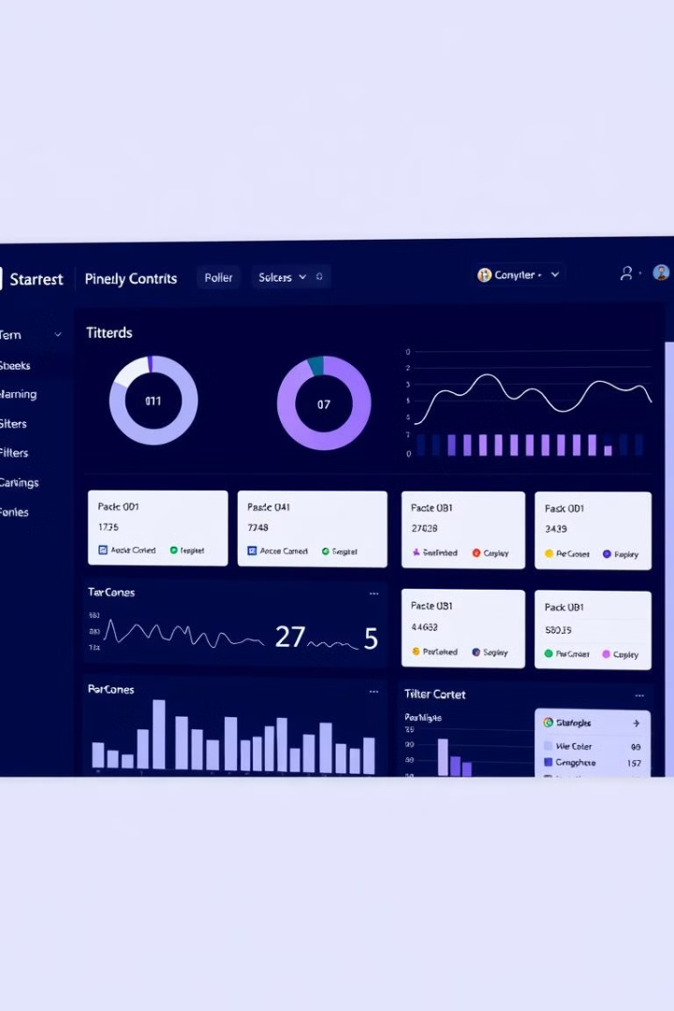
Filters and Slicers
1
Slicers and filters allow users to refine data analysis by selecting specific regions, time periods, or product categories.
2
These interactive elements enable users to customize the dashboard view and explore specific data points of interest.
3
Users can easily drill down into detailed data and uncover hidden trends, leading to better informed decisions.

Slide 8
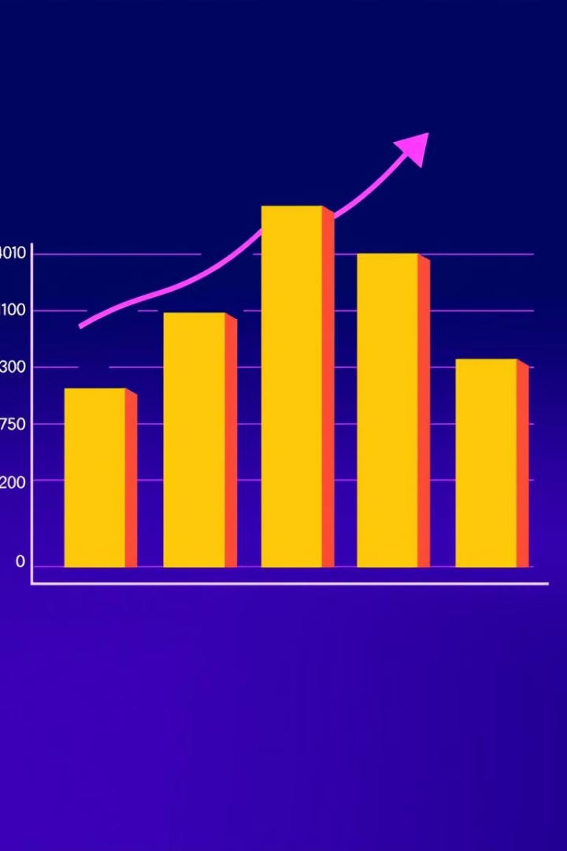



Conclusion and Next Steps
Actionable Insights
The Power BI dashboard provides a comprehensive view of Adidas sales performance, allowing users to identify key trends and opportunities.
Strategic Planning
The insights from the dashboard can inform strategic planning, enabling Adidas to optimize its sales and marketing efforts.
Continuous Improvement
By regularly monitoring and analyzing data, Adidas can continuously improve its performance and achieve its business goals.

